Slide 1
Explore
Japan
Click on a picture to explore.

Slide 2
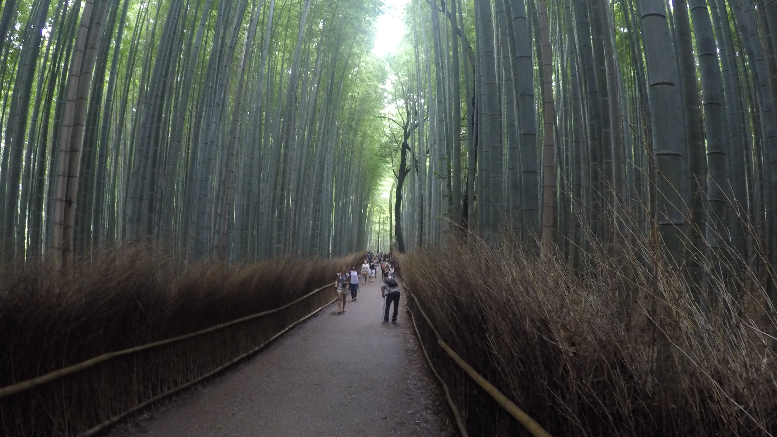
Arashiyama Bamboo Grove
If you’ve been planning a trip to Kyoto, you’ve probably seen pictures of the Arashiyama Bamboo Grove – along with the torii tunnels of Fushimi-Inari-Taisha Shrine and Kinkaku-ji Temple, it’s one of the most photographed sights in the city. But no picture can capture the feeling of standing in the midst of this sprawling bamboo grove – the whole thing has a palpable sense of otherness that is quite unlike that of any normal forest we know of.
In Winter

Slide 3
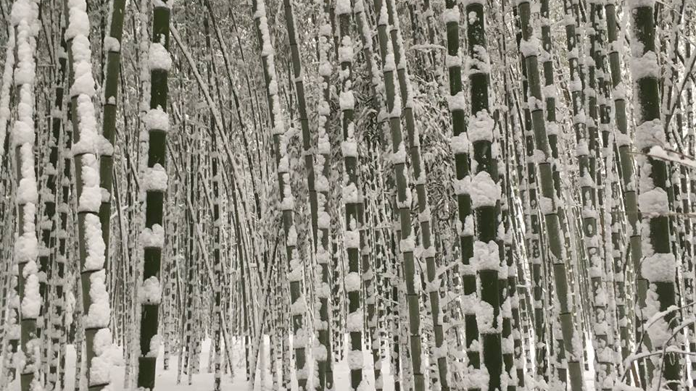
In December, as the last autumn leaves fall and the cold of winter is about to arrive, Arashiyama becomes host to wonderful winter events. The serene air of the hills becomes the perfect setting for experiencing Japanese nature and beauty.

Slide 4
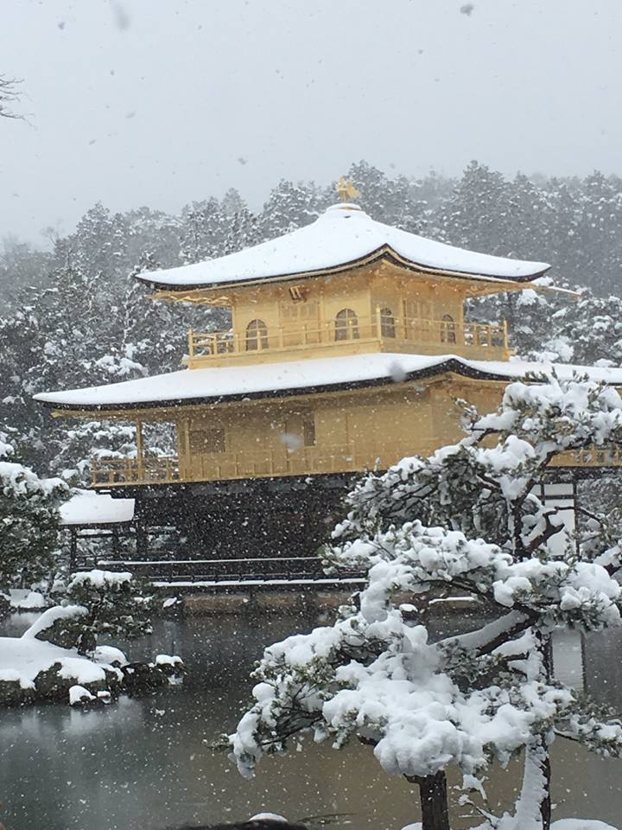
Kinkakuji (金閣寺, Golden Pavilion)
A Zen temple in northern Kyoto whose top two floors are completely covered in gold leaf. Formally known as Rokuonji, the temple was the retirement villa of the shogun Ashikaga Yoshimitsu, and according to his will it became a Zen temple of the Rinzai sect after his death in 1408.

Slide 5
Mt Fuji
Hovering over the metropolis of Tokyo, Mt Fuji is an icon of Japan. This lone volcano is a haven for the natural vacation spots it produces just outside the hectic urban sprawl of the capital.
Video of Mt Fuji from Bullet Train

Slide 7
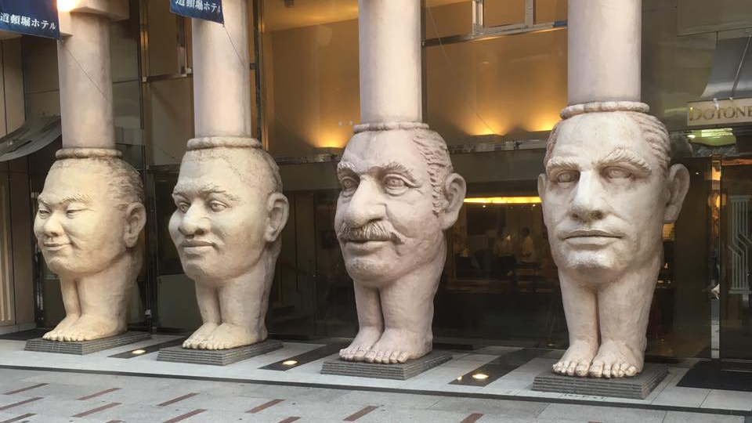
Osaka
Osaka is a charming, relaxed city best known for its food, fun and nightlife—with some history and culture peeking through
Osaka is only a short shinkansen ride from Tokyo, but has a very different personality to Japan's capital city. Hop off the bullet train into an area of exciting nightlife, delicious food and straight-talking, friendly locals. Along with plenty of shopping and modern attractions, Osaka also has a historical side, the highlight of which is Osaka Castle. The castle is a great place to discover more about Japanese history and to wander the beautiful grounds, especially during cherry blossom season in April when the sakura blooms and the weather is often at its best.

