Slide 1
Product Quality

Slide 2
Quality is an important product objective, but quality can mean different things for different products, such as durability, precision, aesthetic appeal, and so on. What does quality mean for the following Products?
Smart phone
Pop-up tent
Athletic Gear
Vacuum cleaner
Pet food
College Education

Slide 3
Smart Phone quality

Slide 4
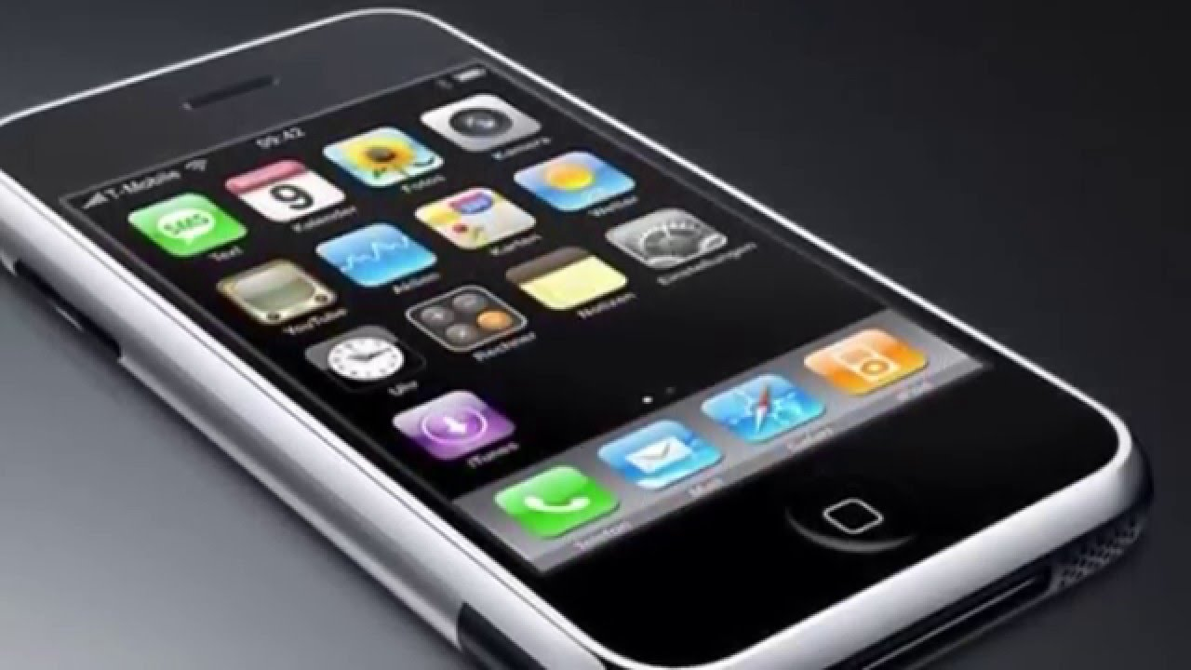
Features and Innovation

Slide 5
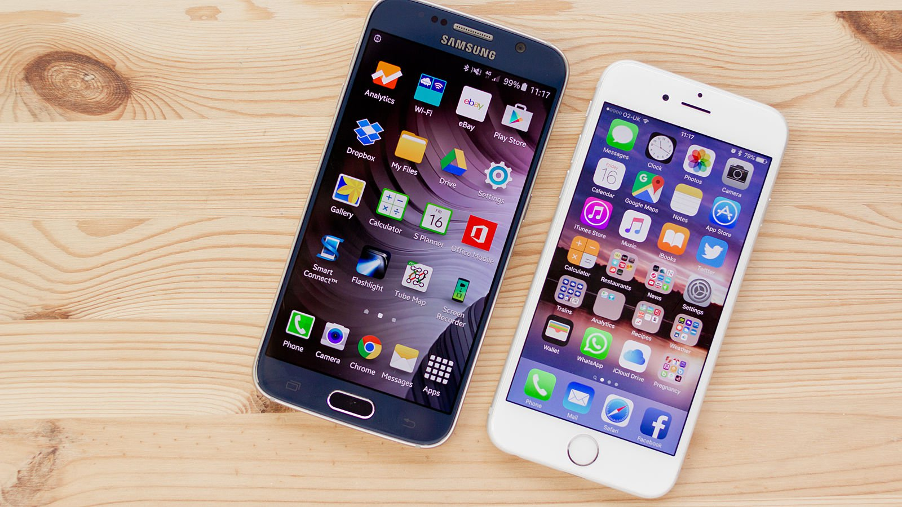
Display

Slide 6
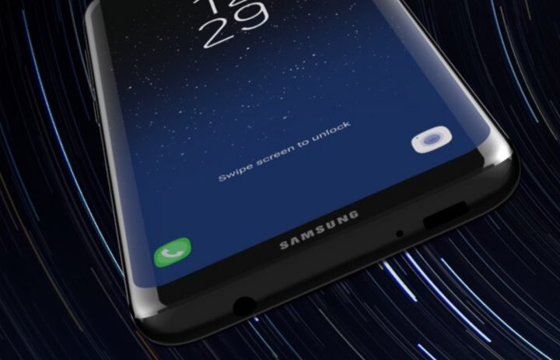
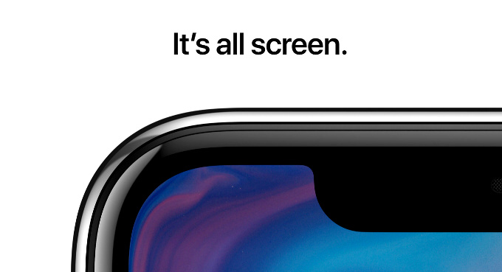
Newer models, bigger screens

Slide 7
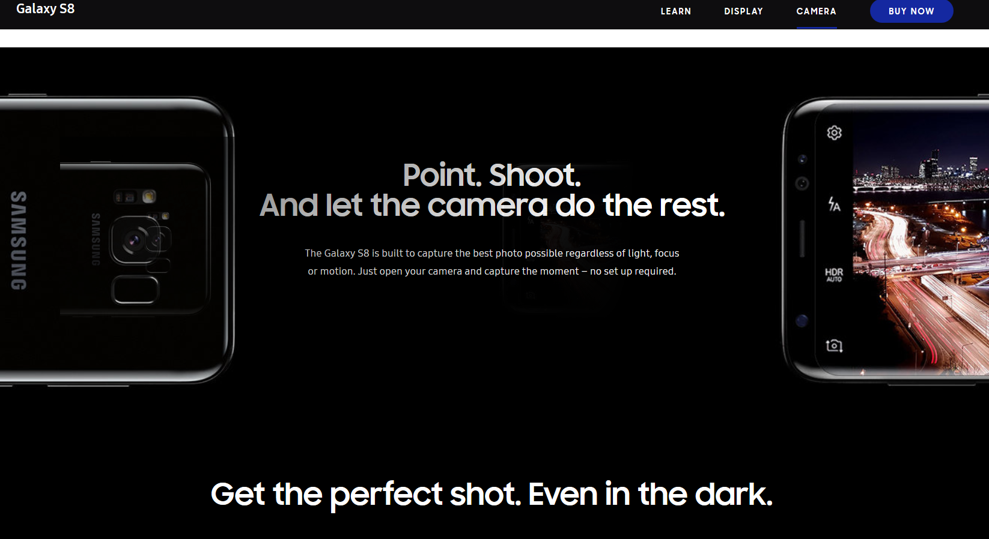
Better but simpler Cameras

Slide 8
What consumers actually want in quality
Longer battery life
More durable device
Better security

Slide 9
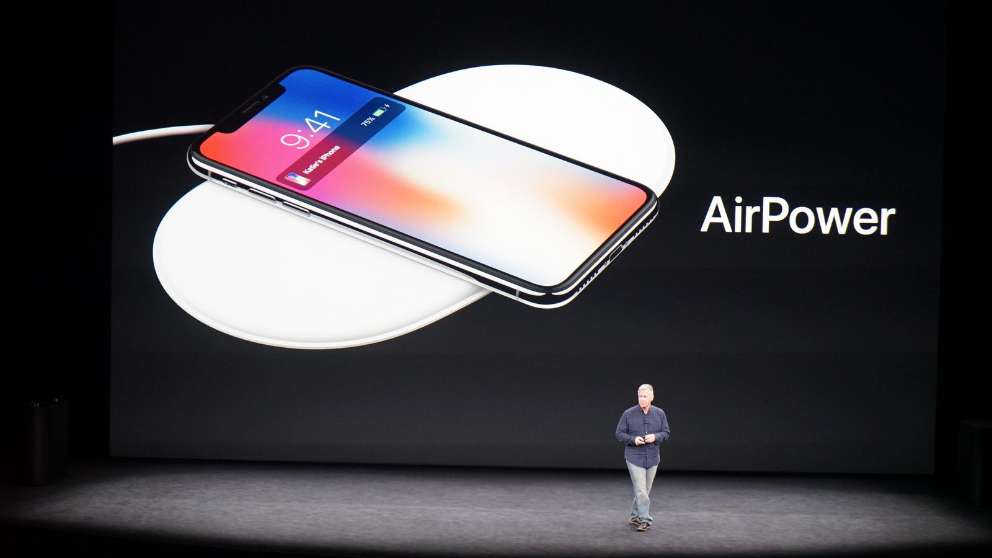
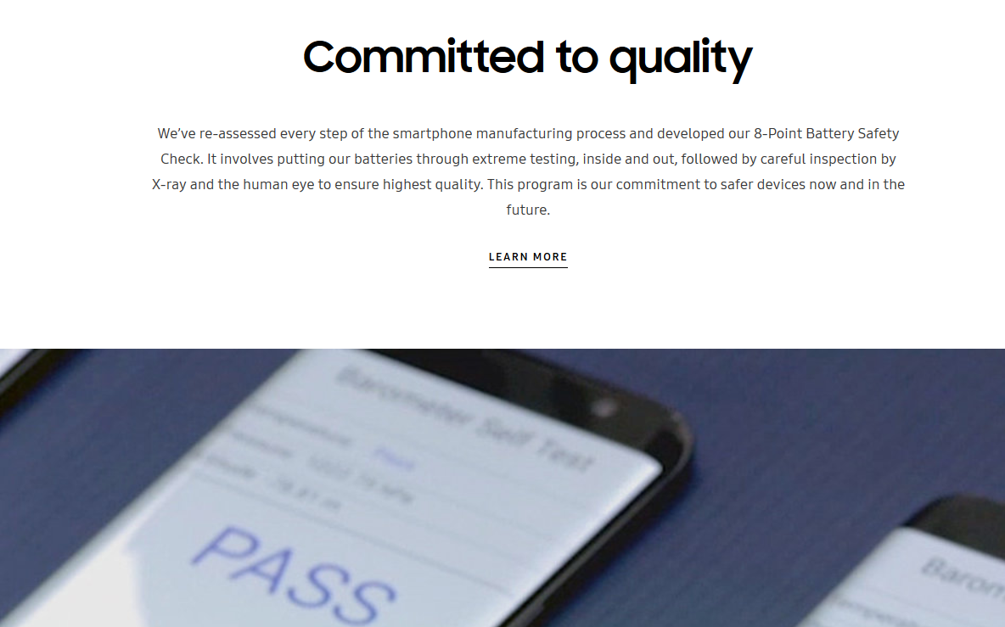
Better quality with batteries and charging
But what about battery life?

Slide 10
More durable
Samsung Galaxy S8?

Slide 11
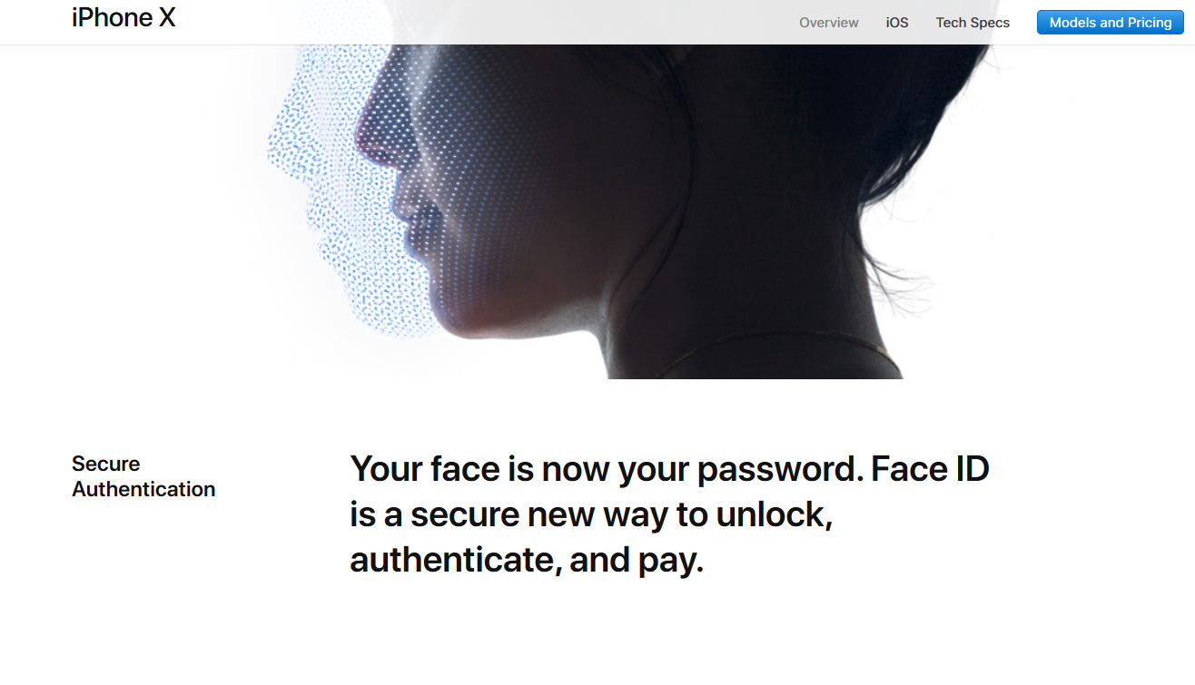
Better Security
But how secure is your information on the network/cloud?

Slide 12
Pop-up tent Quality

Slide 13
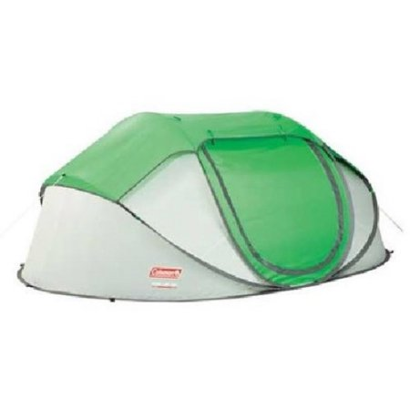
What is a pop-up tent?
A tent that can be assemble and used in less than a couple minutes

Slide 14
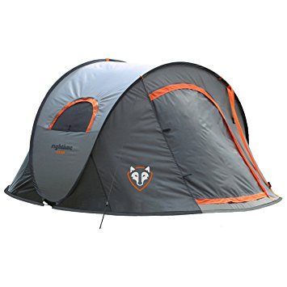
Durability and function

Slide 15
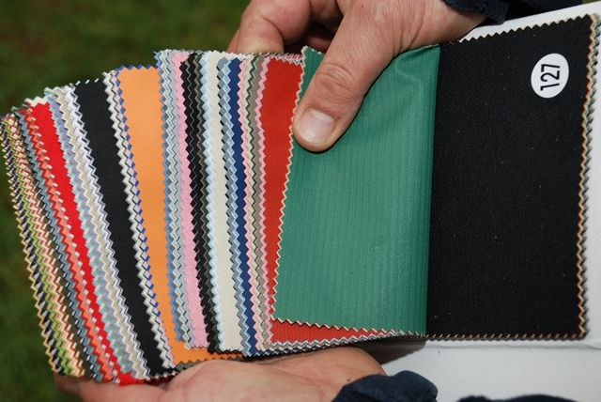
Materials
Usually made from layers of polyester and mesh.

Slide 16
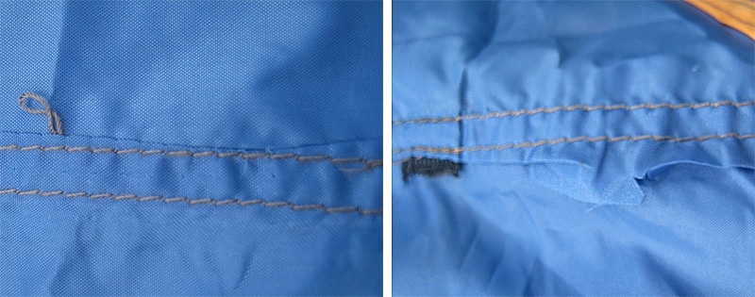
Stitching and seams

Slide 17
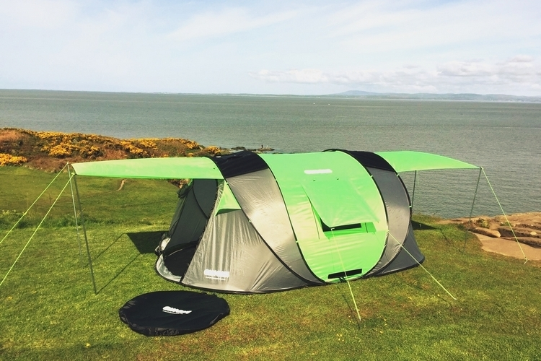
Ratings
3 Seasons
4 Seasons
5 Seasons

Slide 18
Athletic Wear Quality

Slide 19
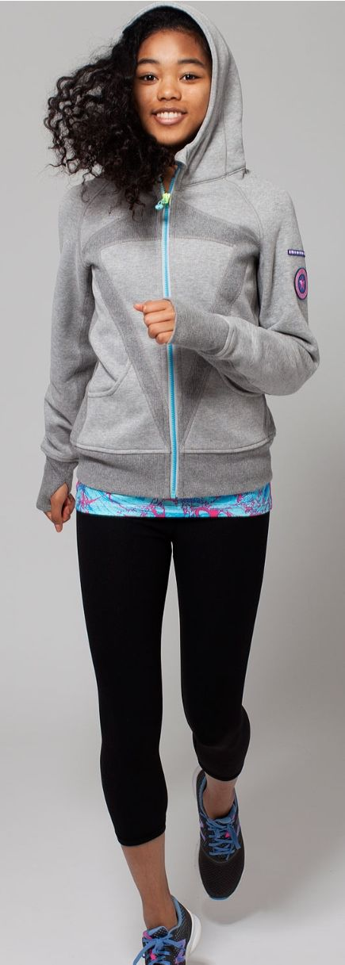
Aesthetic appeal and comfort

Slide 20
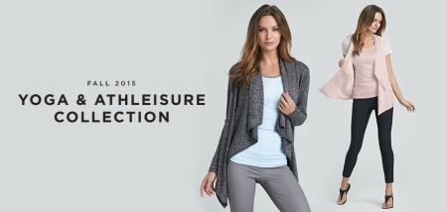
Athleisure fashion

Slide 21
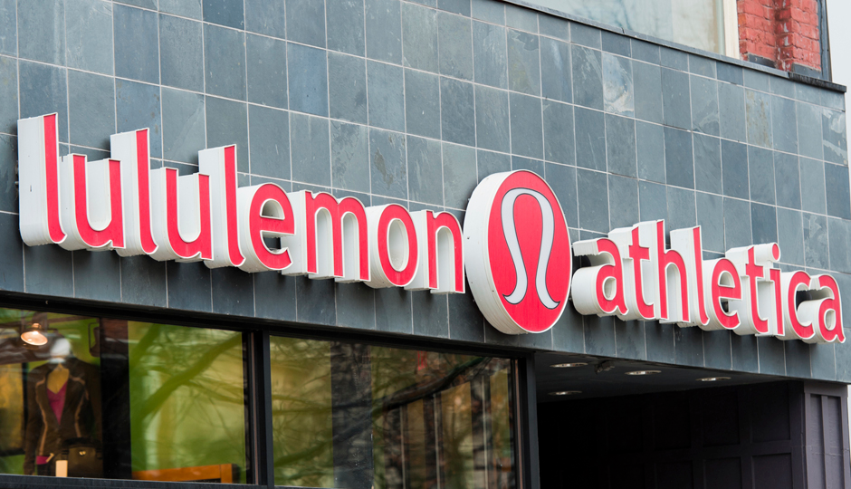
Lululemon

Slide 22
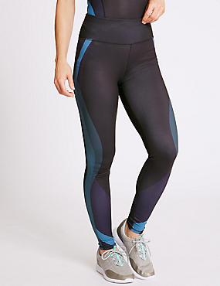
Better Comfort Technology
faster moisture absorption Fabrics
Fabrics that don’t absorb odors
Designed to be better fitting

Slide 23
enclothed cognition
The better the clothes look, the better the confidence
More fashionable, the better the athlete

Slide 24
Lifestyle and brand loyalty.

Slide 25
Vacuum cleaner quality

Slide 26
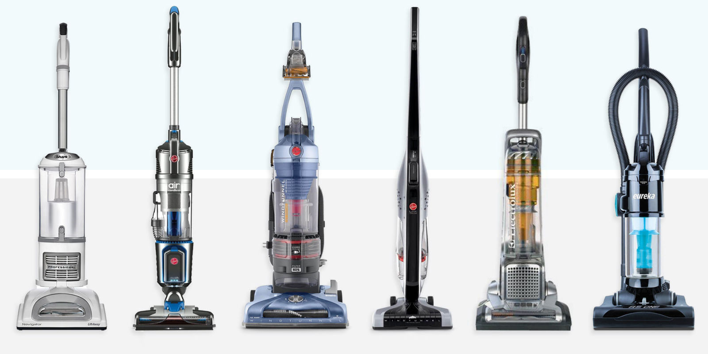
Efficiency and features

Slide 27
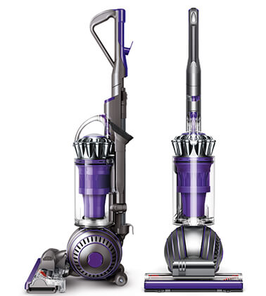
Dyson
“Dual Cyclone” vacuum in 2002

Slide 28
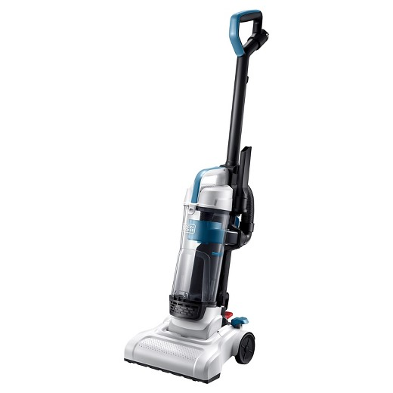
Features that determine quality
Suction power
Maneuverability
Dust and debris removal from vacuum
Power cord length and management
Vacuum attachments

Slide 29
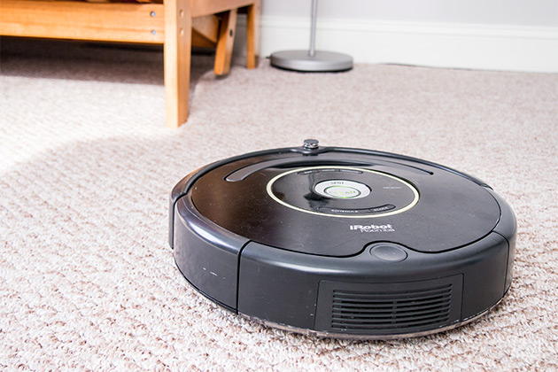
Robotic Vacuums

Slide 30
Pet food quality

Slide 31
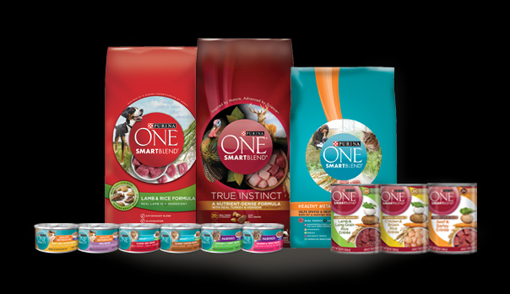
Nutrition and ingredients

Slide 32
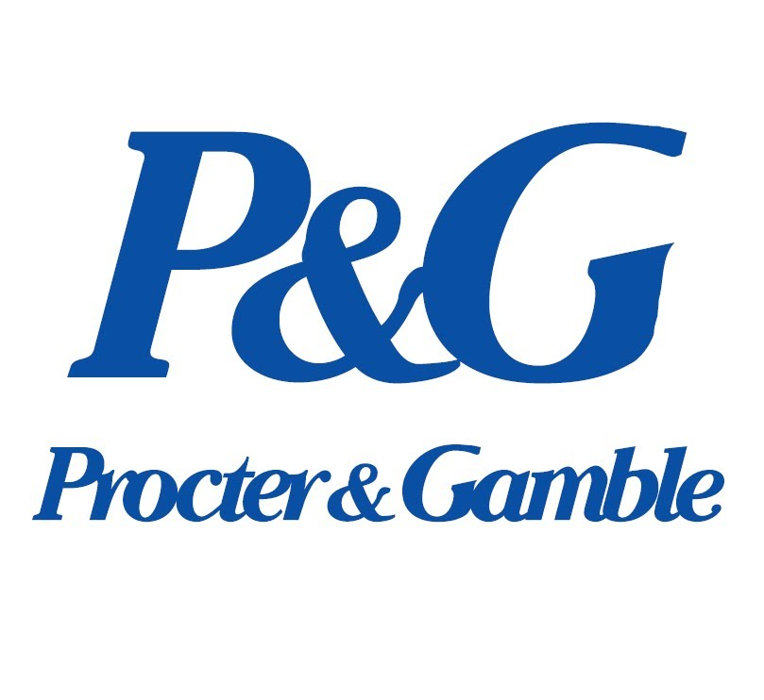
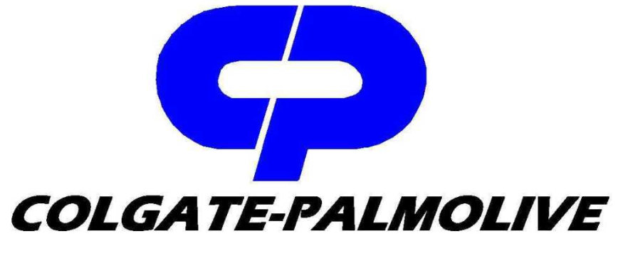
4 companies control 80% of market.
P&G
Nestle
Mars
Colegate-Palmolive

Slide 33
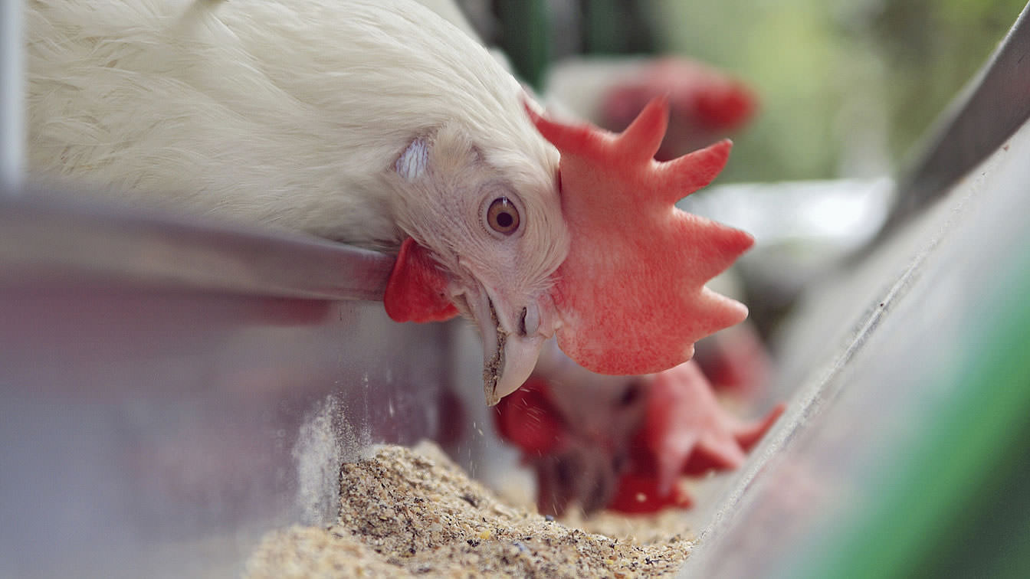
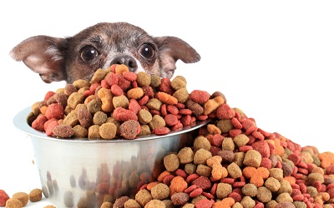
Pet food vs Livestock feed
livestock feed is designed to rapidly fatten-up the animal and is only concerned with short term health; only keeping the animal healthy until slaughter.
Pet food – to the contrary – is used (in hopes) to sustain a pet for many years.

Slide 34
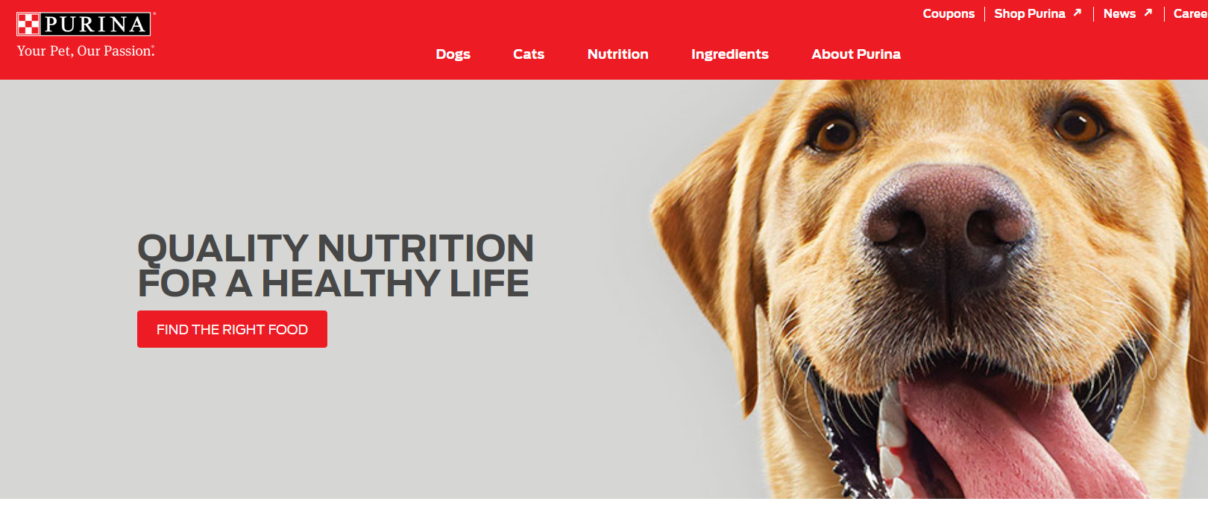
Nutrition

Slide 35
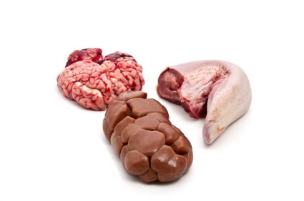
Offal and other Animal by-products
Internal organs
Entrails
bone

Slide 36
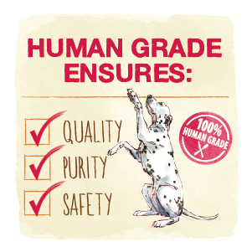
Human Grade Pet Food

Slide 37
College Education Quality

Slide 38
Value
How much money is spent on the student to the relationship of the skills and knowledge a student obtains for the full benefit of their college education.

Slide 39
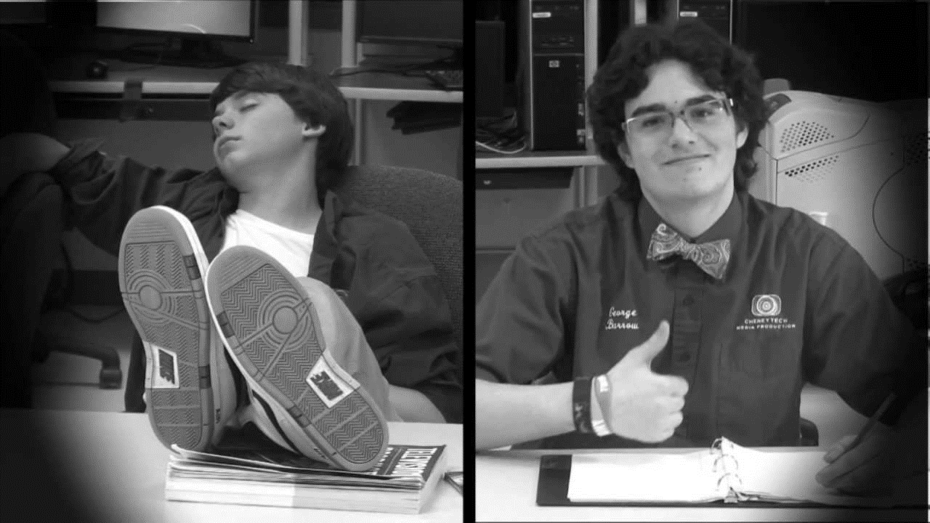
Student selectivity
Better students can faster master skills and knowledge, so more can be expected out of a program.
Worse students can slow the progression of mastering skills and knowledge, even if there are better students in a class.

Slide 40
Amount spent per student on academics
A higher amount correlates better quality programs
Attracts better students and faculty

Slide 41
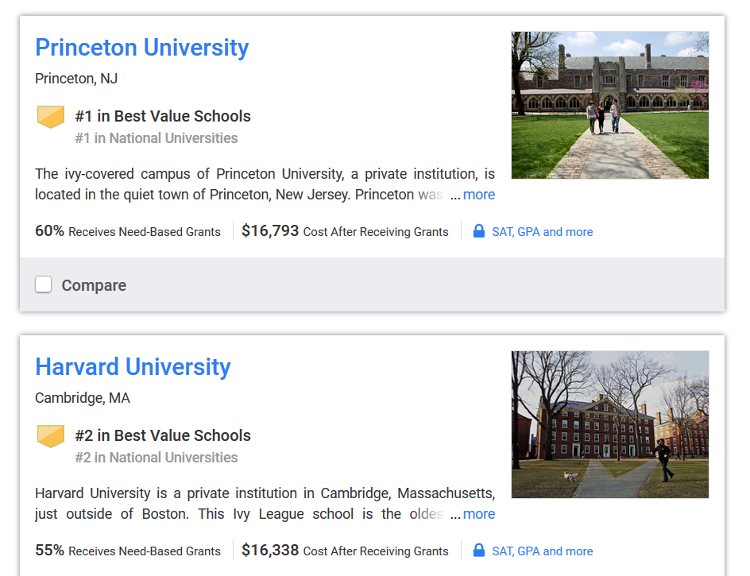
Large Endowments
Princeton has the largest per-student endowment at $2.8 million per student.
Harvard has the largest endowment at $37.6 billion

Slide 42
Appalachian State Endowment

