Slide 1
Multilingual franca approach

Slide 2
Essence of multilingual franca approach:
Language is a social practice. Researchers focus on the “doing” of language within globalized localities. Especially in language contexts where local realities reflect global embeddedness and where global cannot be thought of without the local.

Slide 3
Examples of researcher focus
multicultural global teams
expatriate assignments
negotiations or mergers of global companies

Slide 4
Methodological approaches
Multilingual franca is all about context, surveys and interviews are not enough. Observation and audio recording of the speaker can show how voices are positioned by switching languages, parodying accents, dialects, intonations, mixing media, silences, and so on. Researchers also have to understand wider social, cultural, and historical processes.

Slide 5
Example of Methodology
Audio recorded naturally occurring workplace conversations.
Interviews relating to speakers’ biological backgrounds.
Follow-up interviews with the participants regarding their position within the global organization.
Archival material providing information on the broader context.

Slide 6
Corporate Language Policy
The multilingual franca approach puts forward a language policy that acknowledges the fluidity and hybridity of language use. The benefits is that it could emphasize the creativity and dynamism of mixed languages and produce new possibilities of speaking and communicating providing opportunity and latitude for social and political change from below.

Slide 7
Multilingual franca approach
to the linguistic performance of global teams
Can be suitable to examine how global team members’ linguistic performance is lined to the ongoing productivity of their subjectivity. The main focus of research is understanding how resourceful speakers, through their translanguaging practices, try out, resist and change identity categorizations. Team members also create identities in the performance of language.

Slide 8
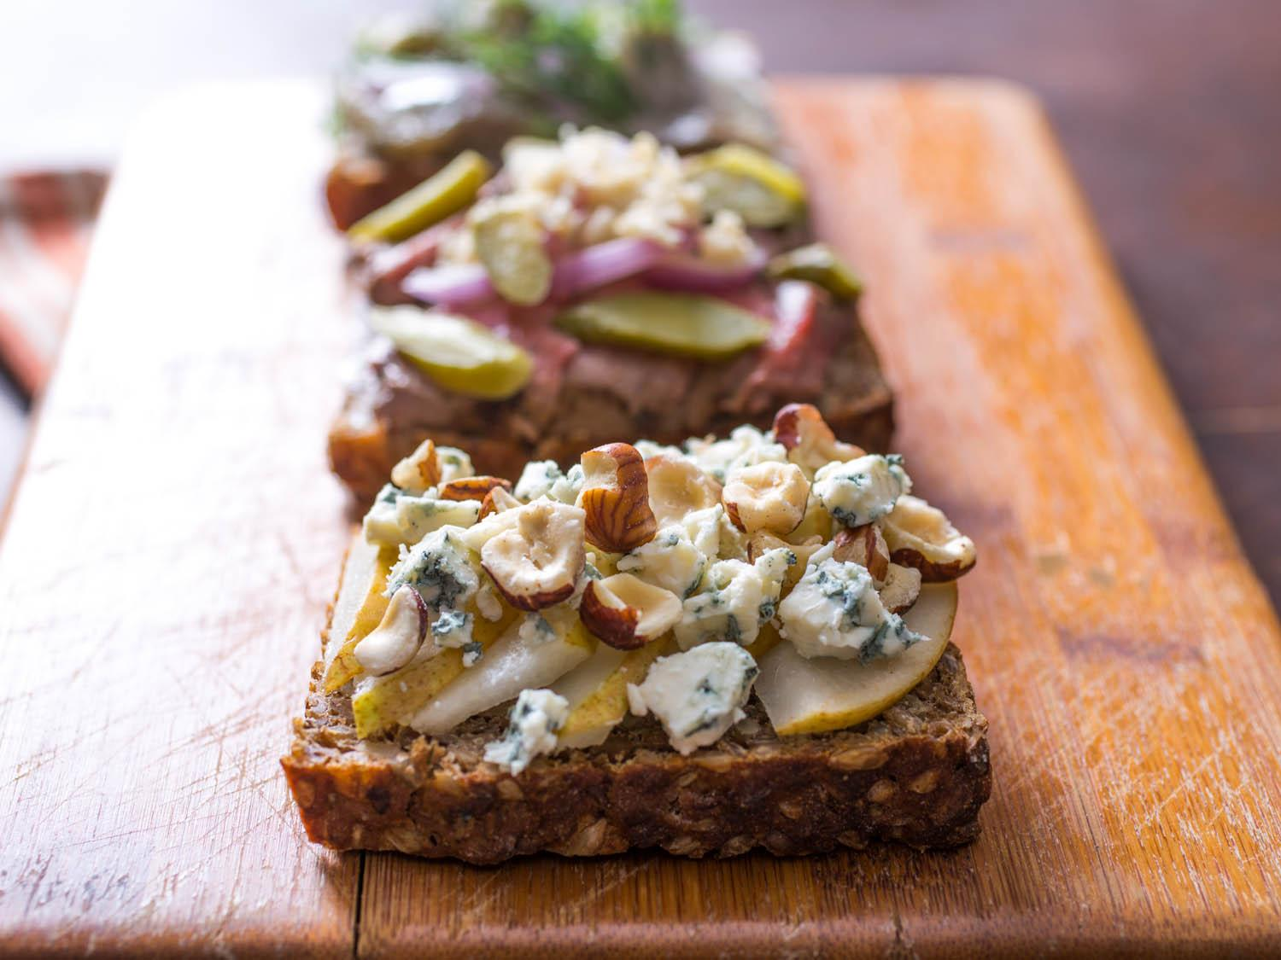
Smørrebrød
Parody and stylization are important ways in which people try out, resist and change identity categorizations.
For example, how a team member from Australia pronounces the Danish word “Smørrebrød” with a caricatured Australian accent which is aimed at Danish team members’ perceptions of how Australian colleagues perceive and articulate aspects of Danish.
Stereotypical Danish Food

Slide 9
Multilingual franca use
and lingua franca English
Multilingual franca approach assumes that lingua franca does not necessarily consist of one language. If global teams choose English as their lingua franca, it is an assumption that more complex pattern of language mixing will emerge. English becomes a “global” language, a hybrid language enacted in a social process.

Slide 10
Conclusion
Lingua franca and multilingualism: pre-existing entity and both consider universality and particularity to be separate notions.
Multilingual franca: language is a social activity, universality and particularity are intertwined.

Slide 11
Multilingua approach advantages
Conceiving MNCs as sites where global and local co-produce each other.
Conceiving language as a social activity, it highlights how users mobilize linguistic resources to express voice.

Slide 12
Discussion

Slide 13
What are some of the advantages and disadvantages of a company adopting a multilingual franca approach to a language policy?

Slide 14
With this class’s primary language of English, and not many native English speakers; it is assumed that multilingual franca processes are occurring. (ie. hybrid language, mixed elements, parody, etc.) What are some examples?

Slide 15
Notes:
Sample Gastonese English
“got plum madder "n a wet hen last week. I tell you whut. . .he better be glad he's suspended, or else I reckon a few of our boys woulda showed up at his doorstep one night, know whudda mean? We ain't takin' that kinda trash off'n no city slicker, I don't keer how damn high and mighty him and his whole polluted town thinks they are. . . . . . . .I mean "at thang, too!. . . . . . .By God."

